Slide 1

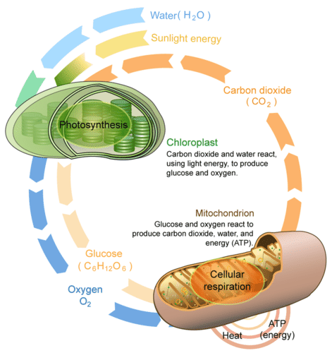

Slide 2
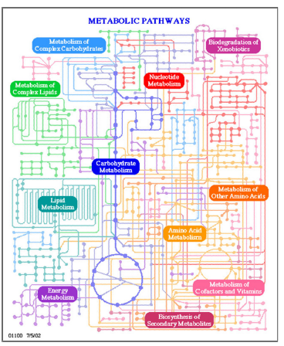
The network

Slide 3
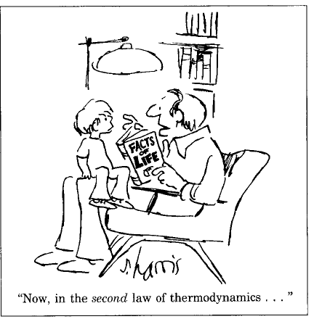

Slide 4
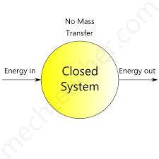
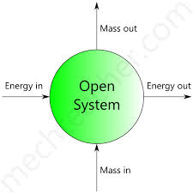
The first law of thermodynamics is a version of the law of conservation of energy, adapted for thermodynamic systems. The law of conservation of energy states that the total energy of an isolated system is constant; energy can be transformed from one form to another, but can be neither created nor destroyed. The first law is often formulated.
ΔU = Q − W .
It states that the change in the internal energy ΔU of a closed system is equal to the amount of heat Q supplied to the system, minus the amount of work W done by the system on its surroundings. An equivalent statement is that perpetual motion machines of the first kind are impossible

Slide 5
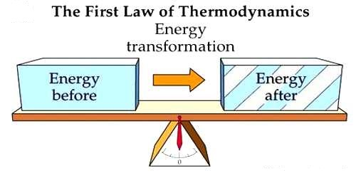

Slide 6
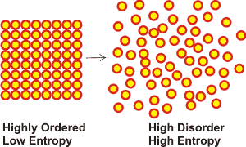
In statistical mechanics entropy is an extensive property of a thermodynamic system It is closely related to the number Ω of microscopic configurations (known as microstates) that are consistent with the macroscopic quantities that characterize the system (such as its volume, pressure and temperature). Under the assumption that each microstate is equally probable, the entropy-S, is the natural logarithm of the number of microstates, multiplied by the Boltzmann constant k_{B}.
S = k B ln⁡Ω
The second law of thermodynamics states that the total entropy of an isolated system can never decrease over time.

Slide 7
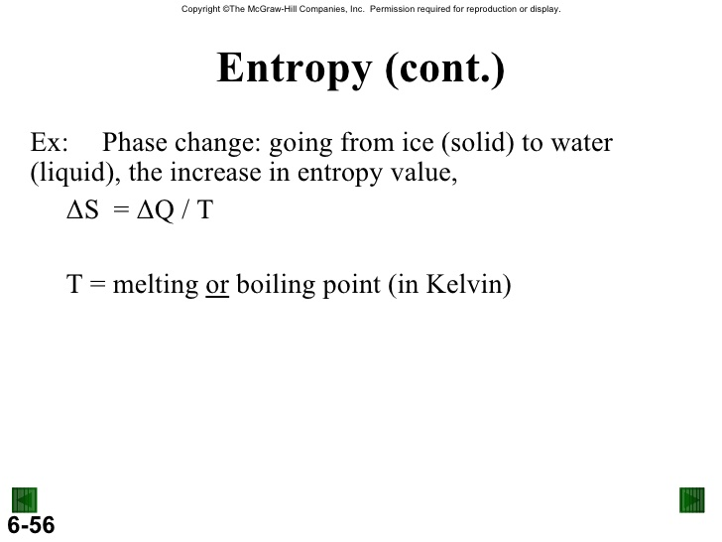
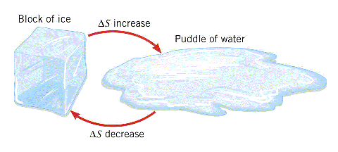

Slide 8
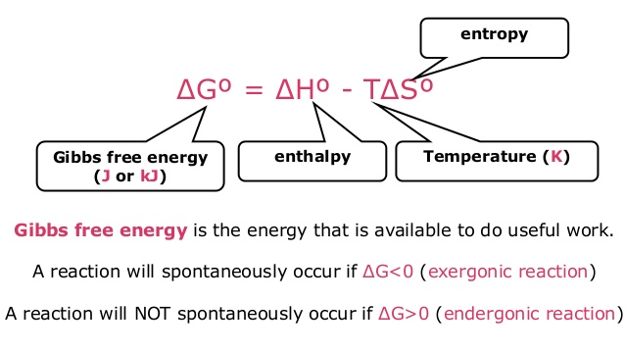
G- Free energy
H- Heat content
S- Randomness

Slide 9
Gibbs free energy, G, expresses the amount of energy capable of doing work during a reaction at constant temperature and pressure. When a reaction proceeds with the release of free energy (that is, when the system changes so as to possess less free energy), the free-energy change, G, has a negative value and the reaction is said to be exergonic. In endergonic reactions, the system gains free energy and G is positive.
Enthalpy, H, is the heat content of the reacting system. It reflects the number and kinds of chemical bonds in the reactants and products. When a chemical reaction releases heat, it is said to be exothermic; the heat content of the products is less than that of the reactants and H has, by convention, a negative value. Reacting systems that take up heat from their surroundings are endothermic and have positive values of H.
Entropy, S, is a quantitative expression for the randomness or disorder in a system. When the products of a reaction are less complex and more disordered than the reactants, the reaction is said to proceed with a gain in entropy.

Slide 10
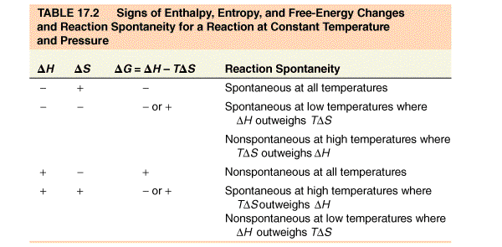

Slide 11
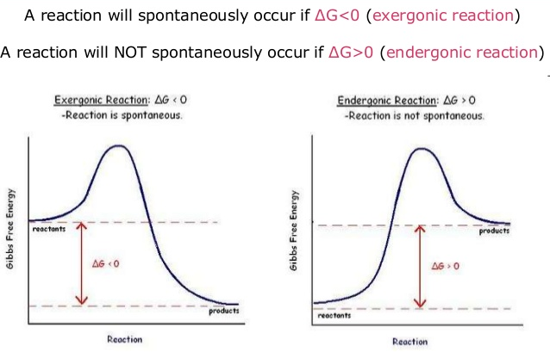

Slide 12
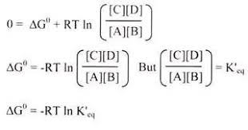
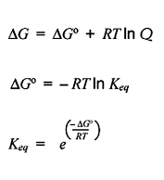
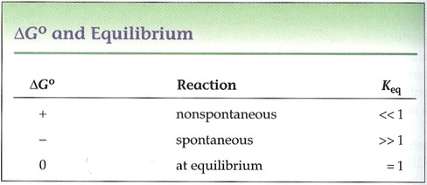

Slide 13
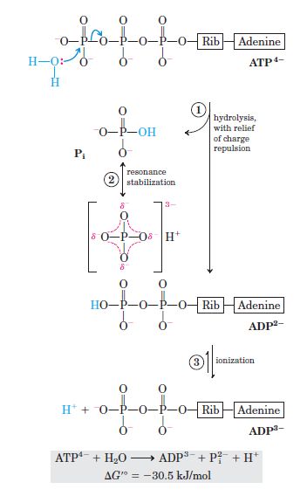
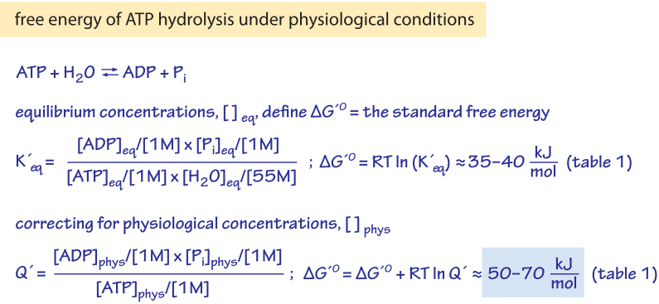
Understanding the energy currency

Slide 14
METABOLISM

Slide 15
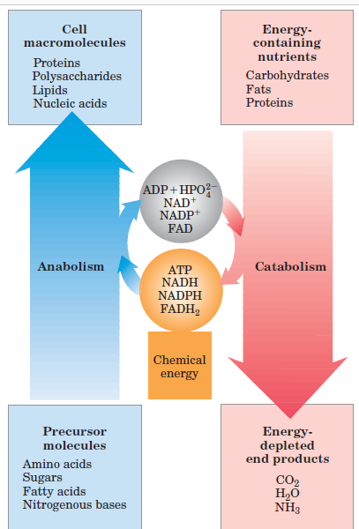
Metabolism = Anabolism + Catabolism

Slide 16
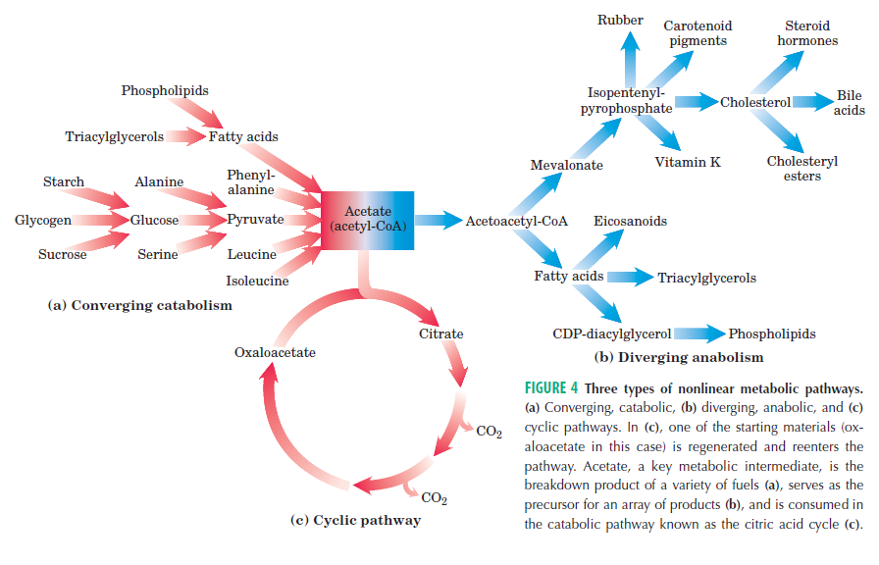
Catabolism converges; Anabolism Diverges

Slide 17
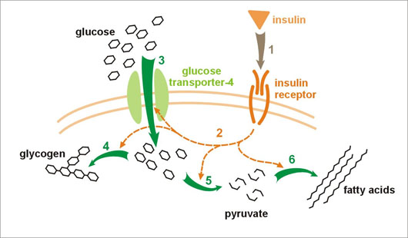
Overview of Glucose metabolism

Slide 18
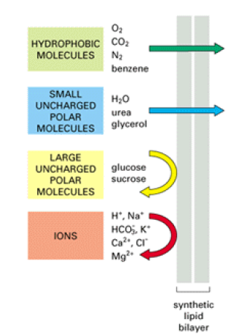
Relative permeability of the membrane

Slide 19
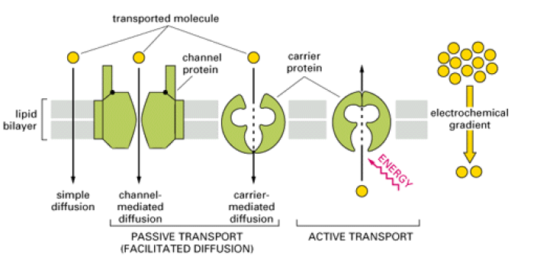
Transport across membrane
Across the concentration gradient- Passive transport (Simple and facilitated diffusion)
Against the concentration gradient- Active transport

Slide 20
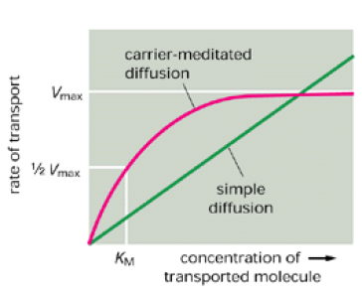
Need of carrier proteins
Passive transport – Difference between Simple and facilitated diffusion.

Slide 21
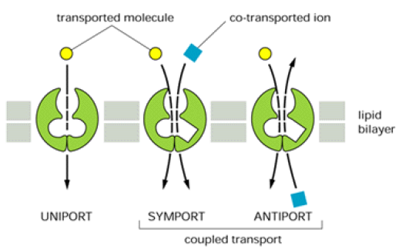
Types of transporters

Slide 22
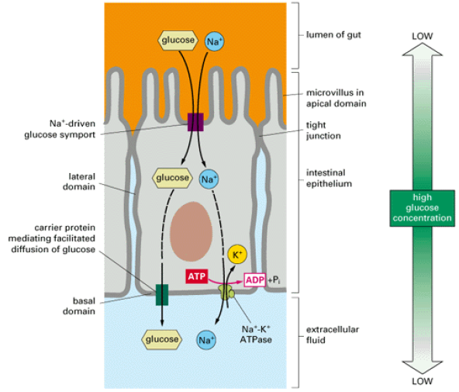
Import of Glucose in cells

Slide 23
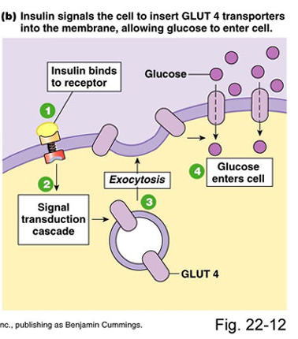

Slide 24
References:
1. Nelson And Cox, Lehninger Principles of Biochemistry, 6th edition
3. Images: Search engine Google.
4. Harper’s Biochemistry 26th Edition.
5. Genes- VIII, Lewin
6. Developmental Biology by Gilbert 7th Edition

